Slide 1
CLV Computational Help (based on All-Star Toys example in CLV lecture)

Slide 2
CLV Computational Example
All-Star Toys & Games, a toy retailer, launched a Birthday Club, where parents provide their children’s toy preferences and their child’s grandparents’ addresses. All-Star sends each grandparent a reminder and hints for gifts two weeks before their grandchild’s birthday.

Slide 3
CLV Example
2,000 new customers were attracted at a cost of $20 each and then tracked over a 3-year period (T = 3). The average annual purchase was $1000.00, with a gross margin of 50% and annual per capita marketing expense of $100.00. All-Star uses a discount rate of 10%, and the retention rate was 40%.
What is All-Star’s 3-year CLV for the Birthday Club?

Slide 4
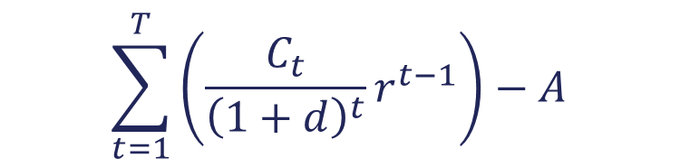
Computational Formula
$$\sum_{t=1}^{T}{\left(\frac{C_{t}}{{\left(1+d\right)}^{t}}r^{t−1}\right)−A}$$
CLV =
C = Cash flow
d = Discount rate
t = Time period
r = Retention probability
A = Acquisition cost

Slide 5
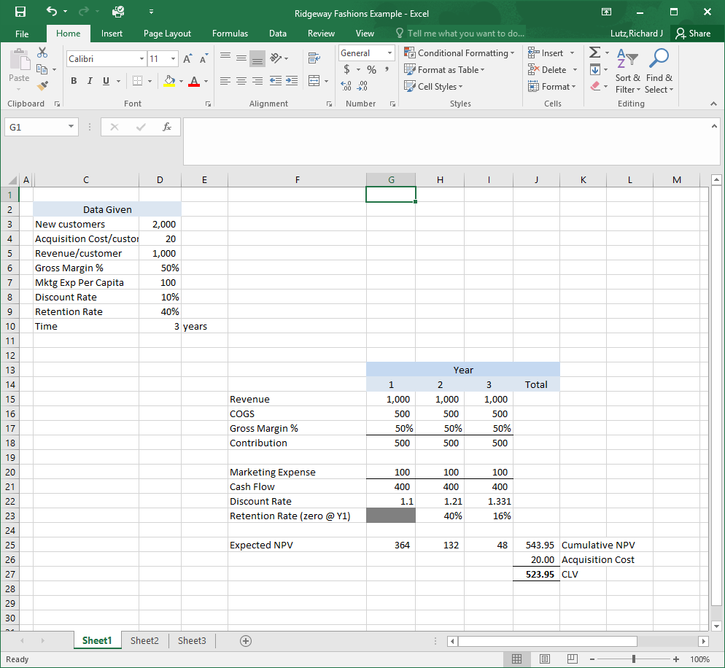
Ridgeway Fashions Example

Slide 6
And the answer is…
$523.95
…(or should be!)*
*If you are more than a few pennies off the above amount, you are doing something wrong.

Slide 7
End of Lecture

